Slide 1
Hackathon Topic Ecommerce Product Categorization
By: Abhishek Puttabasappa

Slide 2
Problem Statement:
In the rapidly evolving world of e-commerce, accurate product categorization is crucial for ensuring seamless customer experiences, reducing search friction, and increasing product discoverability. However, the sheer volume of diverse products poses a significant challenge.
Current classification systems struggle to handle ambiguities, unconventional naming conventions, and multi-language data. This hackathon aims to address these challenges by inviting participants to create innovative solutions that enhance product categorization efficiency, accuracy, and scalability.
Develop a text classification model that categorizes products with maximum accuracy based on description of the product.

Slide 3
Problem Solving Approach
Analyze the dataset
Visualize the data
Preprocess the data
Feature engineering
Address class imbalance
Build multi-class classifier
Evaluate performance
Fine-tune models
Predict on test data

Slide 4
Key Insights
The Online Platform's highest selling product Category is Clothing followed by Jewellery.
The Online Platform has moderate sales in Categories such as Footwear, Automotive, Mobiles & Accessories, Home Decor & Festive Needs, Kitchen & Dinning, Computers.
The Online Platform's least selling product Category is Bags, Wallets & Belts followed by Baby Care, Pens & Stationary, Toys & School Supplies, Tools & Hardware, Watches.

Slide 5
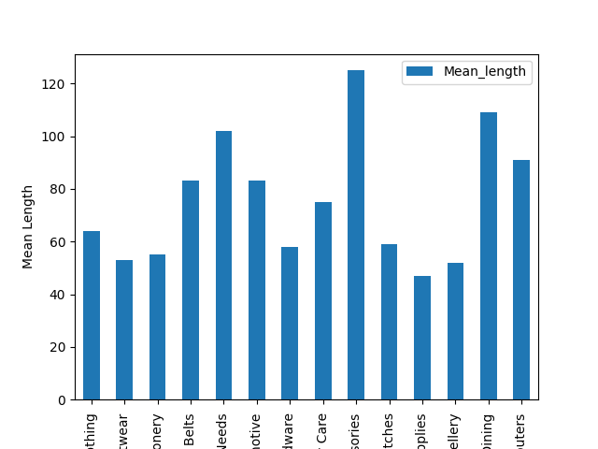

Slide 6
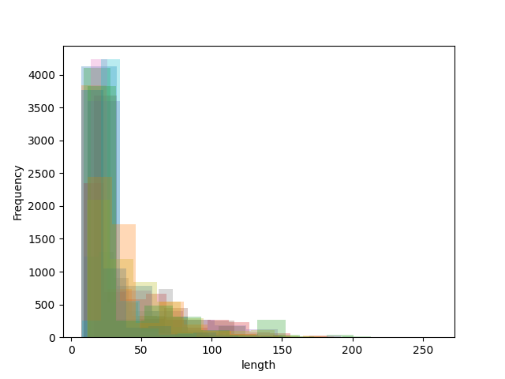
Histograph of the category description lengths

Slide 7
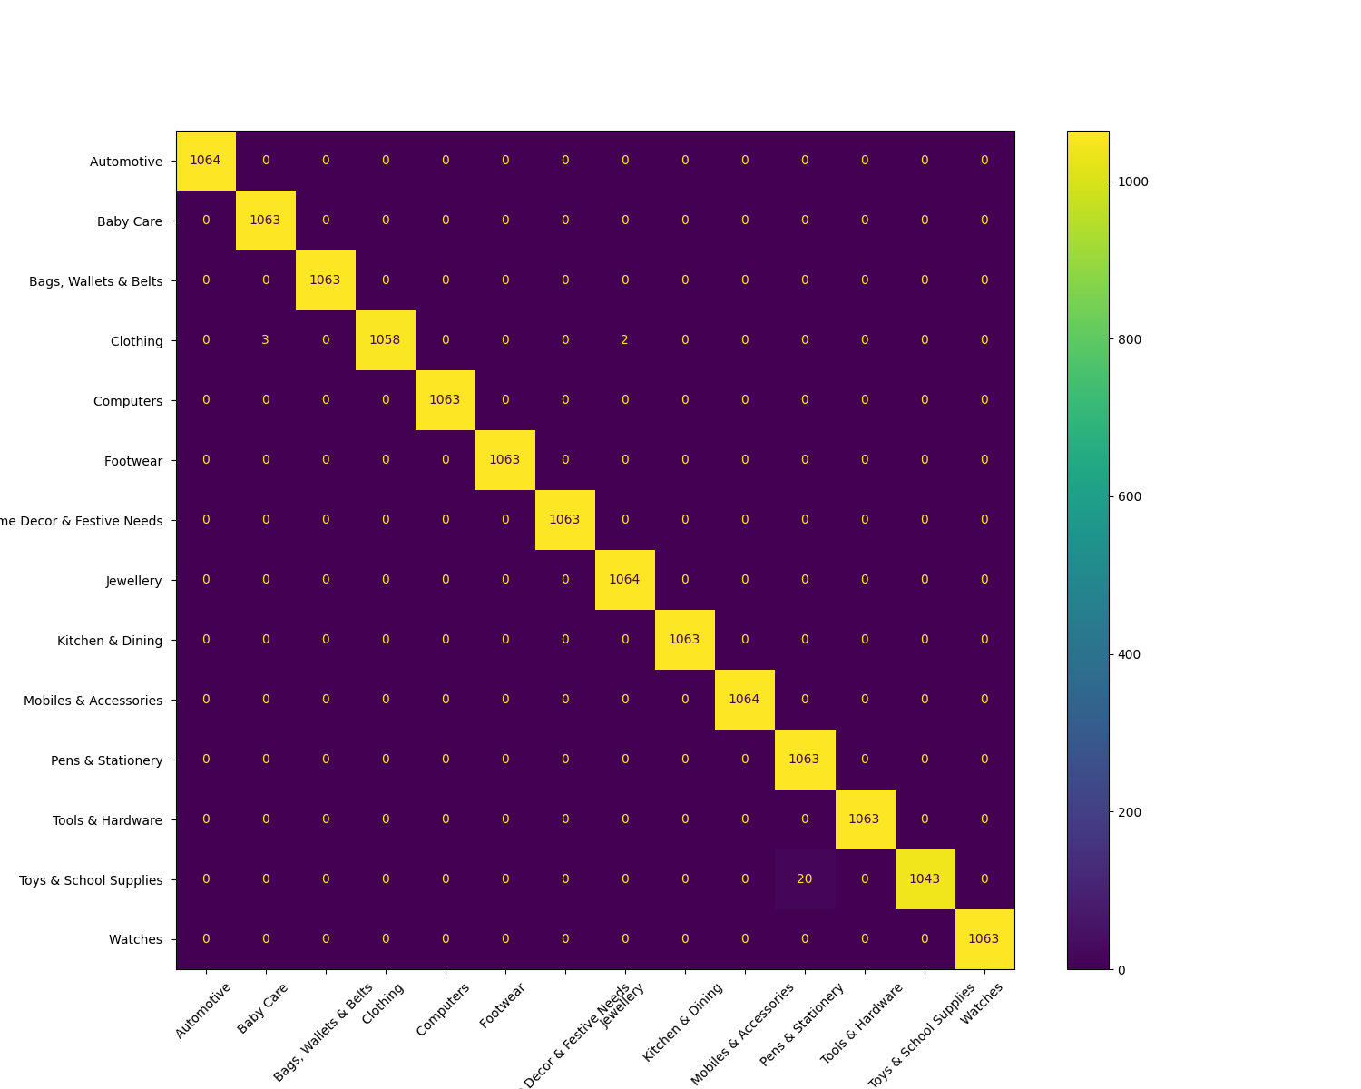
Random Forest Confusion Matrix

Slide 8
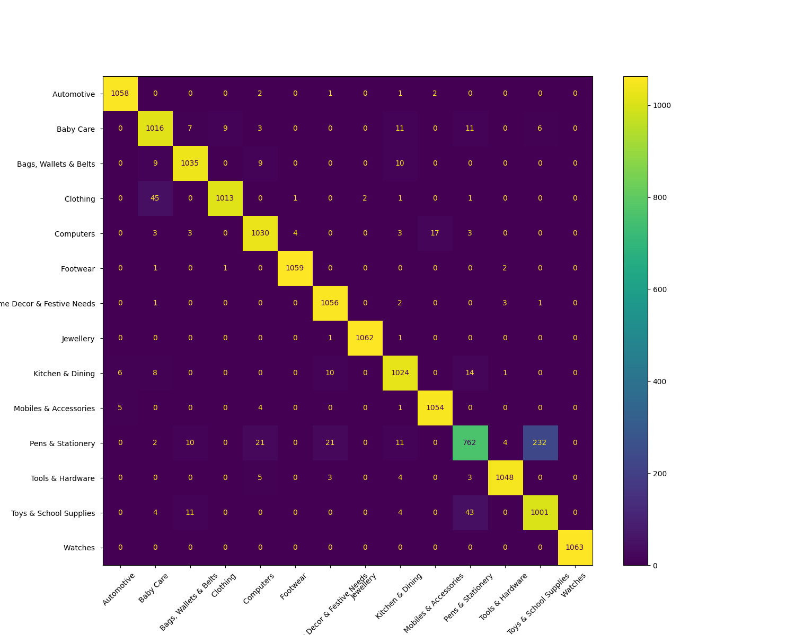
SVC Confusion Matrix

Slide 9

Logistic Regression Confusion Matrix

Slide 10
Testing with Upgrad’s test data

Slide 11
Business value provided by this solution
The business value of using a multi-class text classification model for product categorization can be significant, especially in e-commerce or large retail environments. Here's how it adds value across various aspects

Slide 12
Improved Customer Experience
Enhanced Search and Navigation: With accurate product categorization, customers can more easily find what they're looking for, improving search relevancy and reducing the time spent browsing.
Personalized Recommendations: By categorizing products accurately, companies can tailor recommendations based on category similarities, improving customer satisfaction and increasing chances of conversion.

Slide 13
Operational Efficiency
Automated Product Management: Text classification reduces the time spent manually categorizing products, which can be labor-intensive and error-prone, especially in marketplaces with thousands or millions of items.
Inventory Organization: Clear categorization helps the inventory and supply chain teams organize, restock, and manage products efficiently, optimizing logistics and storage

Slide 14
Enhanced Marketing and Analytics
Targeted Marketing Campaigns: Accurate categories help segment products, allowing marketing teams to target specific product categories for promotions or discounts, leading to higher engagement rates.
Detailed Sales Analytics: Categorization helps analyze product performance by category, providing insights into what categories drive sales, enabling more effective decision-making and inventory investment.

Slide 15
Scalability for Business Growth
Ease of Catalog Expansion: As new products or sellers are added, automated categorization ensures quick, consistent integration into the catalog without overwhelming manual processes.
Cross-Language Applicability: For global companies, the model can help with language and cultural nuances, enabling international expansion with accurate product mapping across markets

Slide 16
Improved Data Quality & Consistency
Consistent Labeling: Automated classification provides consistent categorization, which helps maintain quality and reduces errors frorn human inconsistency.
Unified Product Catalog: This consistency in classification enables easier management of products across various platforms, both internal and customer-facing.

Slide 17
Revenue Growth
Higher Conversion Rates: By making relevant products easier to find, customers are more likely to make purchases, positively impacting revenue.
Reduced Returns: Improved product discovery can reduce instances where customers buy incorrect items, reducing return rates and associated costs.

Slide 18
Competitive Advantage
Enhanced User Trust and Loyalty: A well-organized catalog improves customer perception of the brand and trust in the platform, encouraging repeat purchases and customer loyalty.
Adaptability to Market Trends: Automated categorization keeps the platform agile, allowing for faster adaptation to trends, new product lines, or seasonal items, giving the business a competitive edge.

Slide 19
Thank You

